Slide 1
Purchasing Process Improvement
Zhexuan Zhang
2024/4/5

Slide 2
Table of Contents
01
Problems
02
Solution
03
Control & Risks
What’s wrong with NetSuite?
Why SAP is better?
Controls SAP offers
Risks Caused

Slide 3
01
Problems

Slide 4

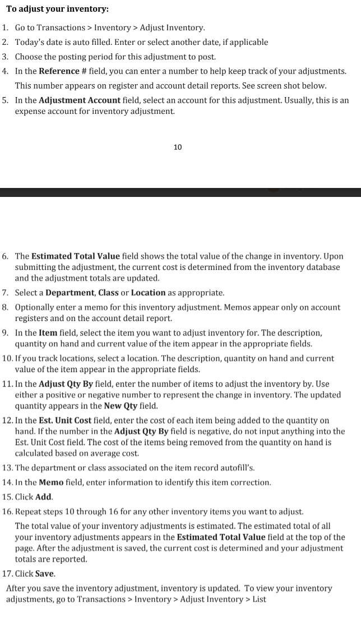
NetSuite
-- A pure cloud-based, developer-hosted ERP software
NetSuite’s designation is geared more towards discrete manufacturing where components are assembled in a predictable and uniform manner.
Outdated Design: The user interface of NetSuite is perceived as outdated, the search functionality is seen as lacking, requiring exact matches or extensive use of wildcards

Slide 5
NetSuite
-- A pure cloud-based, developer-hosted ERP software
Barcode scanning functionality is limited to certain transaction types and is reportedly unreliable unless additional services are purchased.
Overall, day-to-day operations are slowed down considerably by NetSuite compared to Other systems like SAP

Slide 6
02
Solution
SAP is better? Why?

Slide 7

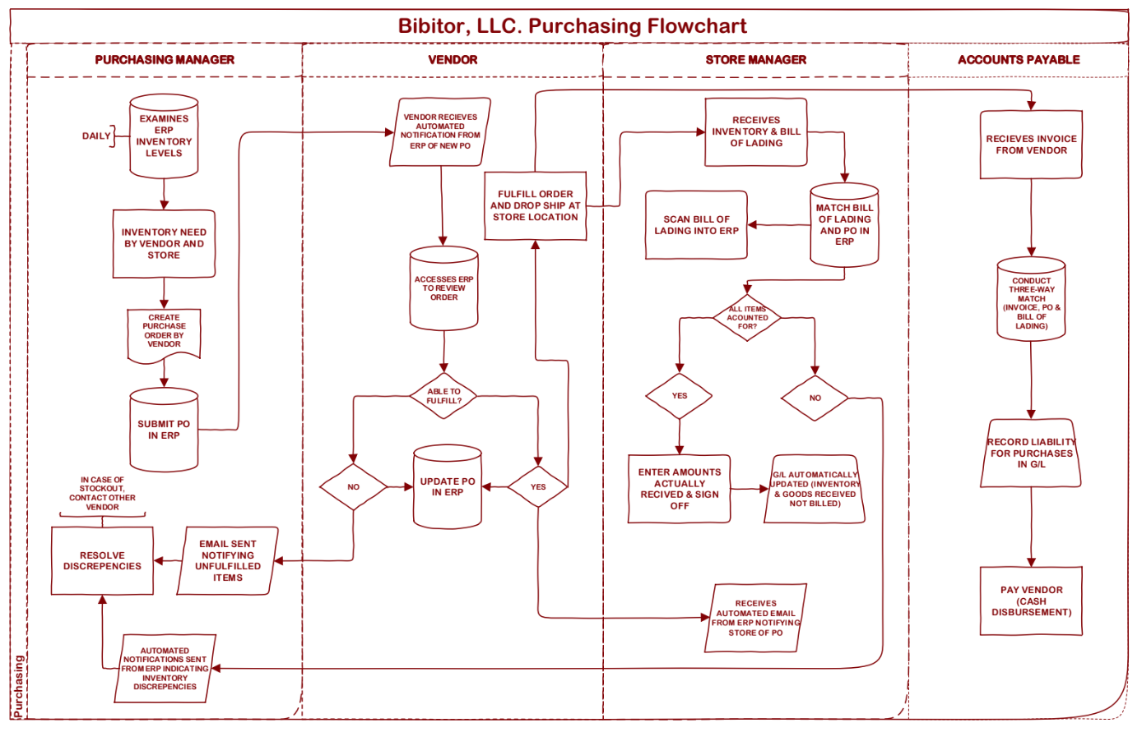
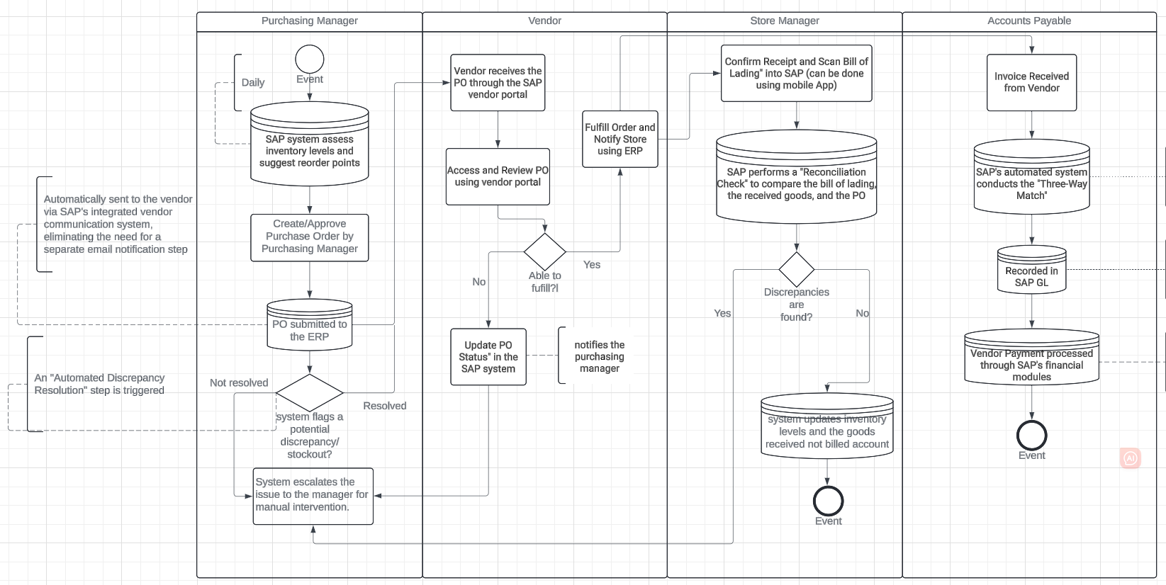
SAP S/4HANA
--Modern ERP system both On-Premises & Cloud-based
On-premises solutions typically offer a higher degree of customization and control over the system.
SAP HANA is an in-memory database management system for high-performance, real-time applications.

Slide 8
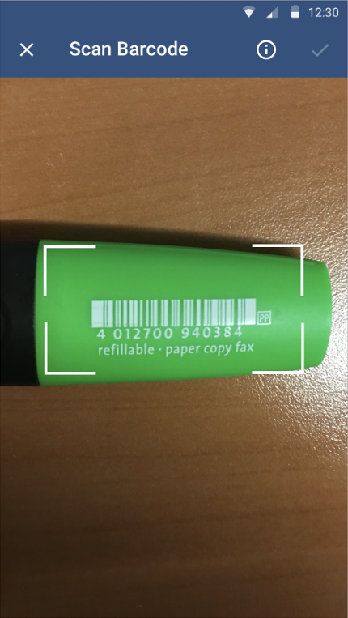
SAP S/4HANA
--Modern ERP system both On-Premises & Cloud-based
It is possible to complete the following for material records by scanning a barcode or QR code on a mobile device:
Search or match for existing material records using a supported barcode or label. When searching using a barcode, the application will search for all fields contained in the barcode record.

Slide 9
03
Control & Risks

Slide 10
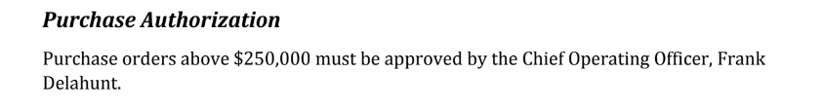
Procedural & Financial Control
Optimized Spend Management
Businesses can identify spending trends and anomalies, enabling them to make cost-effective purchasing decisions.
Customizable Approval Workflows
Ensures that purchases are not only automated but also adhere strictly to company policies and budget constraints.
Automated Compliance Monitoring
Ensuring that all purchases meet regulatory standards and company policies.

Slide 11
Risks
Implementation Delays
Transitioning to a comprehensive system like SAP ERP can sometimes lead to implementation delays. These delays can occur due to the complexities of integrating legacy systems, data migration, or the need for extensive customization
Data Migration Errors
As data is migrated from NetSuite to SAP ERP, there's a risk of errors that can lead to inaccurate financial reporting or compliance issues.

Slide 12
REFERENCE LIST
https://help.sap.com/docs/SAP_FIELD_SERVICE_MANAGEMENT/fsm_release_documentation/2308-release.htmllease | SAP Help Portal
https://learning.sap.com/learning-journeys/discovering-sap-business-network-supply-chain-collaboration-features-and-functions/describing-an-advance-ship-notice-s-place-within-the-purchase-order-collaboration-process-flow_a415b3cc-fa79-4670-bb9e-21b1f467d591 (sap.com)
SAP S/4HANA Rhttps://softwareconnect.com/erp/sap-s4hana/eview: 2023 Pros, Cons, Ratings (softwareconnect.com)
NetSuite vs SAP: Ultimate Comparison Guide (Updated for 2024) (techfino.com)
CHATGPT (chat.openai.com)

